Slide 1
NHERI GSC
January General Meeting

Slide 2
Agenda
12:00-12:02 Welcome & Announcement
12:02-12:04 NHERI GSC Mini-Conference & Research Challenge
12:04-12:08 NHERI GSC Vice Nominations
12:08-12:38 Dr. Ian Robertson
12:38-12:58 Breakout Rooms
12:58-1:00 Wrap up

Slide 3


Welcome New Members
Donglei | Wang
Fariha | Rahman
MD Fahimuzzaman | Khan
Wilfred | Lunga
Teodora | Mitroi
Sayedul | Kibria
Farinaz | Motlagh
Kayode | Adeniji
Miguel | Aguilar
Natalie | Coleman
Daniel | Osborn
Christine | Phyathep
Prabin | Sharma
Yvonne | Dadson
Chengxin | Feng
Christine | Phyathep
Joy | Semien
Daniel | Muschett Henriquez
Sohel | Rana
Arjun | Basnet
Benjamin | Goings
William | Hughes
Amy | Kitchener
Notes:
https://designsafe-ci.zoom.us/meeting/register/tJwufuqqqzIvGtccud5YOr45cD5P181IQnwa

Slide 4

NHERI Summer Institute
Learn more about the NHERI Summer Institute and how to tailor your application on Friday, January 27th @ 11:00 am CST. Register for the free virtual information
session: https://bit.ly/LearnAboutSummerInstitute.
June
21-23
https://bit.ly/2023NHERI_SummerInstitute
Notes:
https://designsafe-ci.zoom.us/meeting/register/tJwufuqqqzIvGtccud5YOr45cD5P181IQnwa

Slide 5
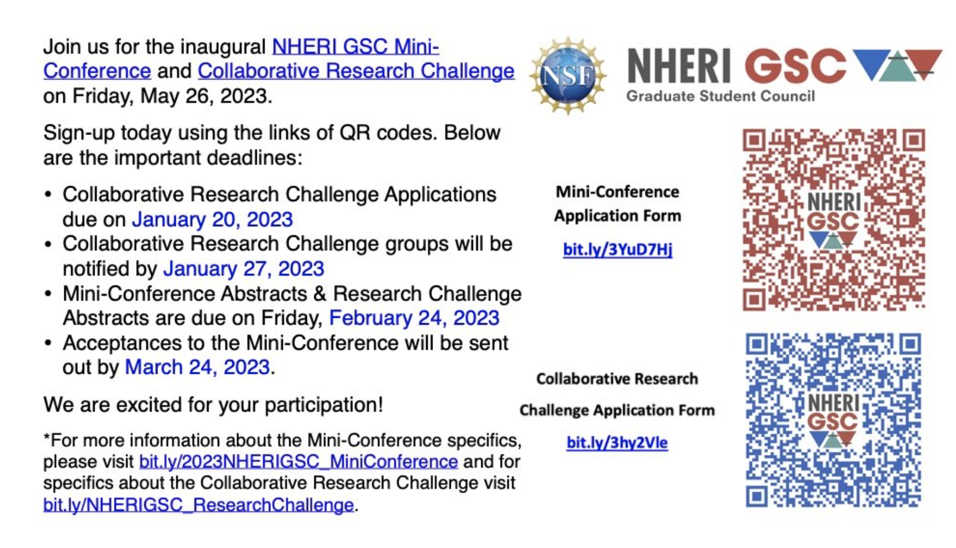
NHERI GSC Mini-Conference
bit.ly/3vNDwaI

Slide 6

NHERI GSC Vice Nominations
Eligibility
Registered member
Belong to a working group
Attended min. 2 NHERI GSC meetings last semester
Positions
Vice-President
Vice-Secretary
Vice-Treasurer
Vice-Chair Workshop & Mentoring
Vice-Chair Research
Vice-Chair Membership
Vice-Chair DEI
Vice-Chair Technology & Comm.
Vice-Chair Networking & Community Building
bit.ly/NHERIGSC_Spring2023Nominations

Slide 7
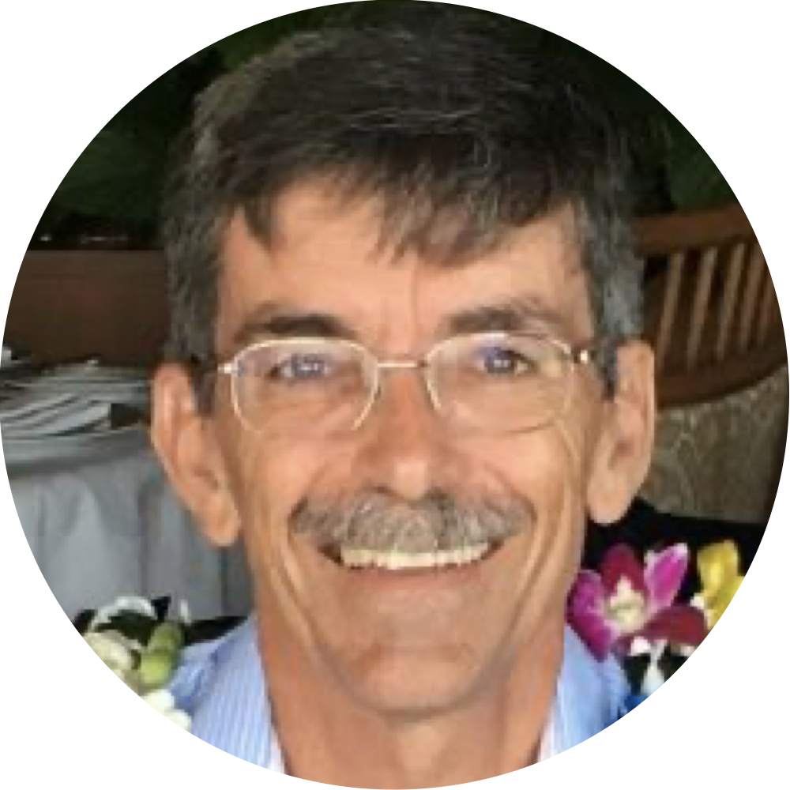
Speaker Introduction
Dr. Ian Robertson
Professor and Chair of Civil and Environmental Engineering
Arthur N.L. Chiu Distinguished Professor
&
Chair for NHERI Science Plan
ianrob@hawaii.edu
Notes:
Speaker Introduction Slide (Speaker headshot, name, title, university affiliation, email and well written introduction included in the notes below for anyone who has to moderate on the fly)
Include your introduction of the speaker here:
Ian Robertson is a Professor and Chair of Civil and Environmental Engineering as well as the Arthur N.L. Chiu Distinguished Professor. He currently serves as the Chair of the NHERI Science Plan (third edition). He received his doctorate in Civil Engineering from Rice University in 1990 and specializes in Structural Engineering and his research focuses on structural response to earthquakes, tsunamis, hurricanes and long-term effects, multi-hazard mitigation and structural rehabilitation, and field reconnaissance after natural hazard events.

Slide 8
Breakout Rooms (BR)
Please select a research area to participate.
Join the Research BR room that you are most interest in participating.
Earthquake
Wind
Tsunami
Coastal Engineering
Cyberinfrastructure
Simulation/Computational Modeling
Reconnaissance
Social Science

Slide 9

Future Meeting Dates
3rd Friday of every month at 11:00am
CST
February
17

