Slide 1
NHERI GSC
October General Meeting

Slide 2
Agenda
11:00-11:05 Introduction/Announcements
11:05-11:40 Ádám Zsarnóczay
11:40-11:55 Research Breakout Rooms
11:55-12:00 Wrap-up

Slide 3

HAPPY BIRTHDAY NHERI
GSC

Slide 4


Calendars
To add events to our NHERI GSC calendars please email our communications team:
Niko Todorov todorov@chapman.edu Edwin Rajeev edwinrajeev@ufl.edu
NHERI GSC Conference Calendar
NHERI GSC Workshop & Events Calendar
bit.ly/NHERI_GSC_ConferenceCalendar
bit.ly/NHERI_GSC_WorkshopsEventsCalendar

Slide 5
Register for
NHERI Summer Institute
*5 NHERI GSC applicants will be selected for an NSF Travel Award
June
21-23
https://bit.ly/2023NHERI_SummerInstitute
Notes:
https://designsafe-ci.zoom.us/meeting/register/tJwufuqqqzIvGtccud5YOr45cD5P181IQnwa

Slide 6
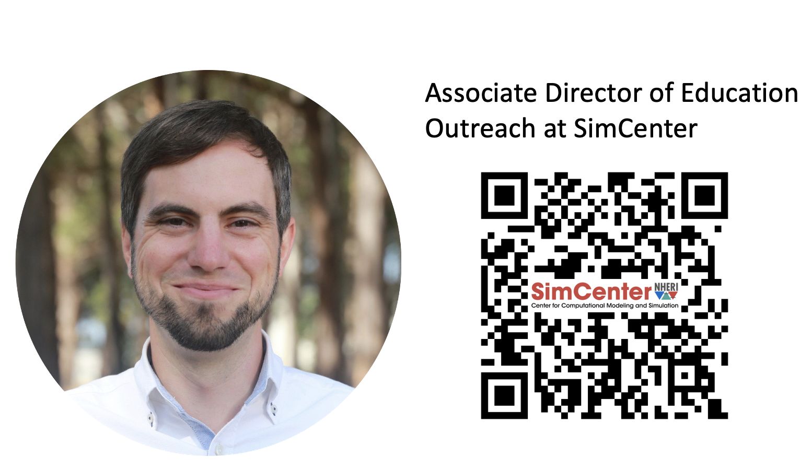
Ádám Zsarnóczay
Associate Director of Research Outreach at SimCenter

Slide 7
Breakout Rooms (BR)
Please select a research area to participate.
Join the Research BR room that you are most interest in participating.
Earthquake
Wind
Tsunami
Coastal Engineering
Cyberinfrastructure
Simulation/Computational Modeling
Reconnaissance
Social Science

Slide 8

Future Meeting Dates
3rd Friday of every month at 11:00am
CST
November
18

