Slide 1
NHERI GSC
March General Meeting
Friday, March 17
11:00am CST

Slide 2
Agenda
12:00-12:05 Welcome & Announcements
12:05-12:35 Dr. Marshall Shepherd
12:35-12:58 Breakout Rooms
12:58-1:00 Wrap up

Slide 3


Welcome New Members
Huy | Pham
Jawed | Aslam
Emmanuel | Zamora Romero
Farida | Sehili
Audrika | Nahian
Michael | Byrne
Rashid | Shams
Lisa | Wang
Samira | Tafazzol
Umar | Khayaz
Sebastiao | Appleton Figueira
Faustina | Owusu
*Reach out to Faith Nenanya and Sasan Dolati to learn how to get involved!

Slide 4
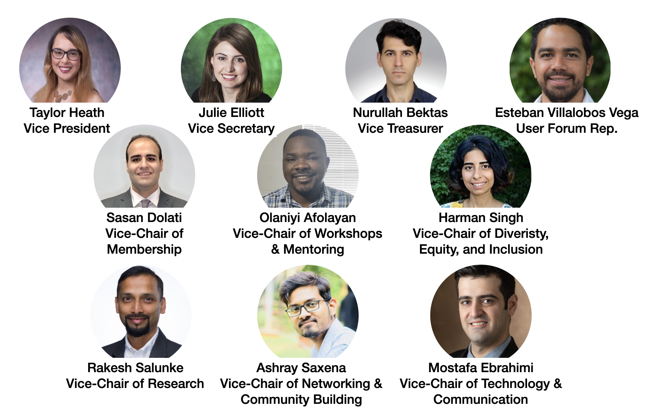
Welcome New Vice-Elects!

Slide 5

NHERI GSC Mini-Conference
Please join us at the inaugural NHERI GSC Mini-Conference!
Friday, May 26, 2023
Full program forthcoming
Register here!

Slide 6
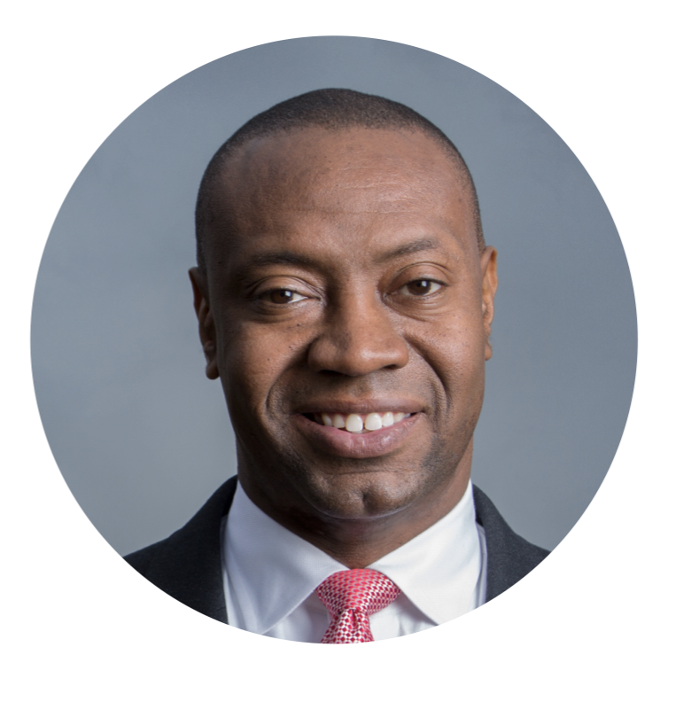
Speaker Introduction
Dr. Marshall Shepherd
Georgia Athletic Association Distinguished Professor
Director, Atmospheric Sciences Program
marshgeo@uga.edu
Watch his presentation on science communication here: https://studio.youtube.com/video/w_9PiB6N2eE/edit
Notes:
Ronnie Schumann is an assistant professor at UNT in the department of Emergency Management and Disaster Science, where he uses his background as a human geographer to explore social vulnerabilities in disasters using quantitative and qualitative methods and community engagement to quantify disaster issues and help build community recovery and resilience in impacted groups. His latest work, "From the Ashes: A study of mitigation policy and practice after wildfire in California" supported through the Natural Hazards Center, FEMA, and NSF "Mitigation Matters Research Program" moves the discipline forward in the area of wildfires, which became even more important in 2022 where over 360,000 acres burned in California.
A fierce supporter of NHERI GSC, Ronnie helped support the first NHERI GSC joint presentation at the 2022 Disaster PRIMR Conference in Denton, and students fortunate enough to take classes from him have spoken about his ability to make the most complex disaster concepts comprehensible for all. Please help me welcome Ronnie to our February NHERI GSC meeting.

Slide 7

Future Meeting Dates
*Join us for the NHERI GSC Workshop and Mentoring Group Meeting on Friday, March 24, and the DEI Workshop with Dr. Haorui Wu on Friday, March 31!
3rd Friday of every month at 11:00am
CST
April
21

