Slide 1
NHERI GSC
August General Meeting

Slide 2
Agenda
12:00-12:05 Introduction/Announcements
12:05-12:30 Ben Roston, Virginia Tech
12:30-12:55 Research Breakout Rooms
12:55-1:00 Wrap-up

Slide 3
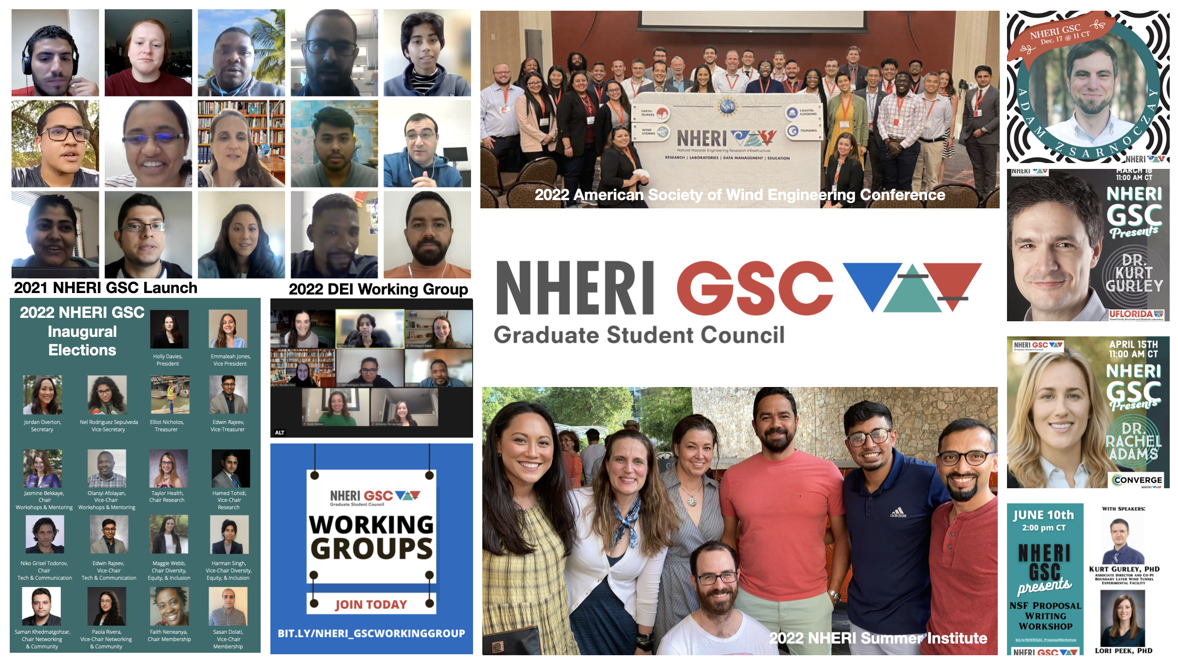
Notes:
Brief Intro about the council and what we do/have accomplished in 2021-2022 AY.

Slide 4
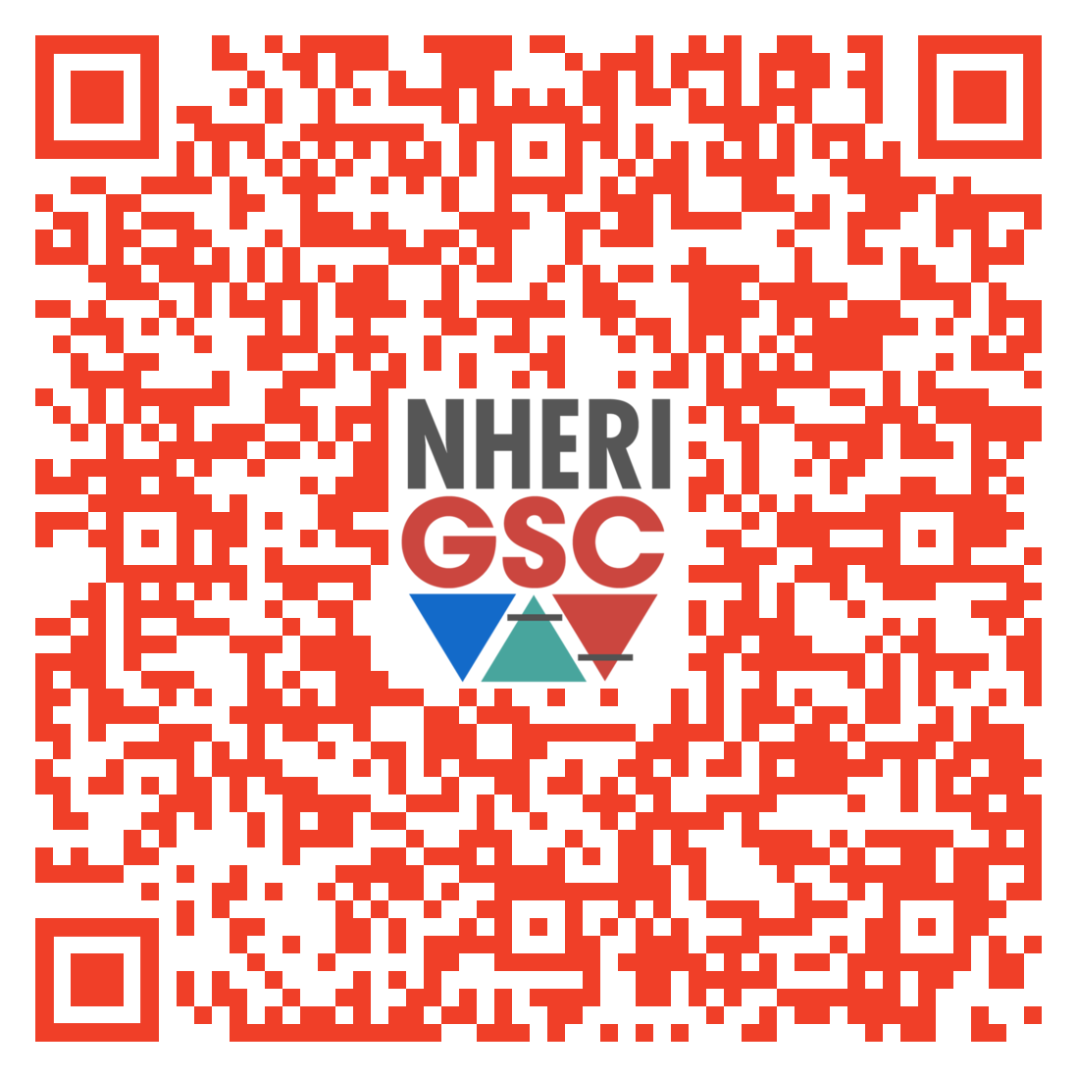
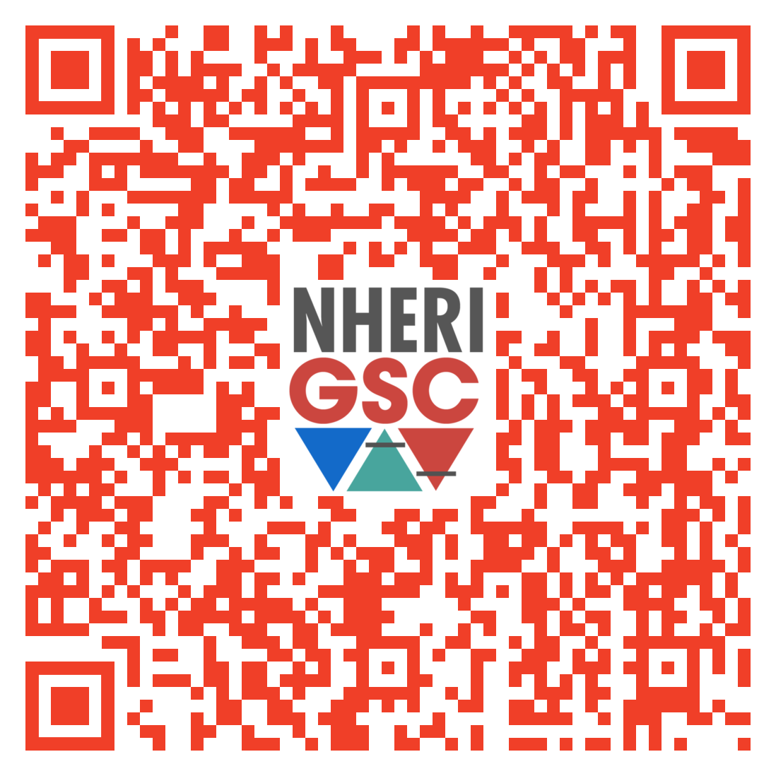
To add events to our NHERI GSC calendars please email our communications team:
Niko Todorov todorov@chapman.edu
Edwin Rajeev edwinrajeev@ufl.edu
NHERI GSC Conference Calendar
NHERI GSC Workshop & Events Calendar
bit.ly/NHERI_GSC_ConferenceCalendar
bit.ly/NHERI_GSC_WorkshopsEventsCalendar

Slide 5
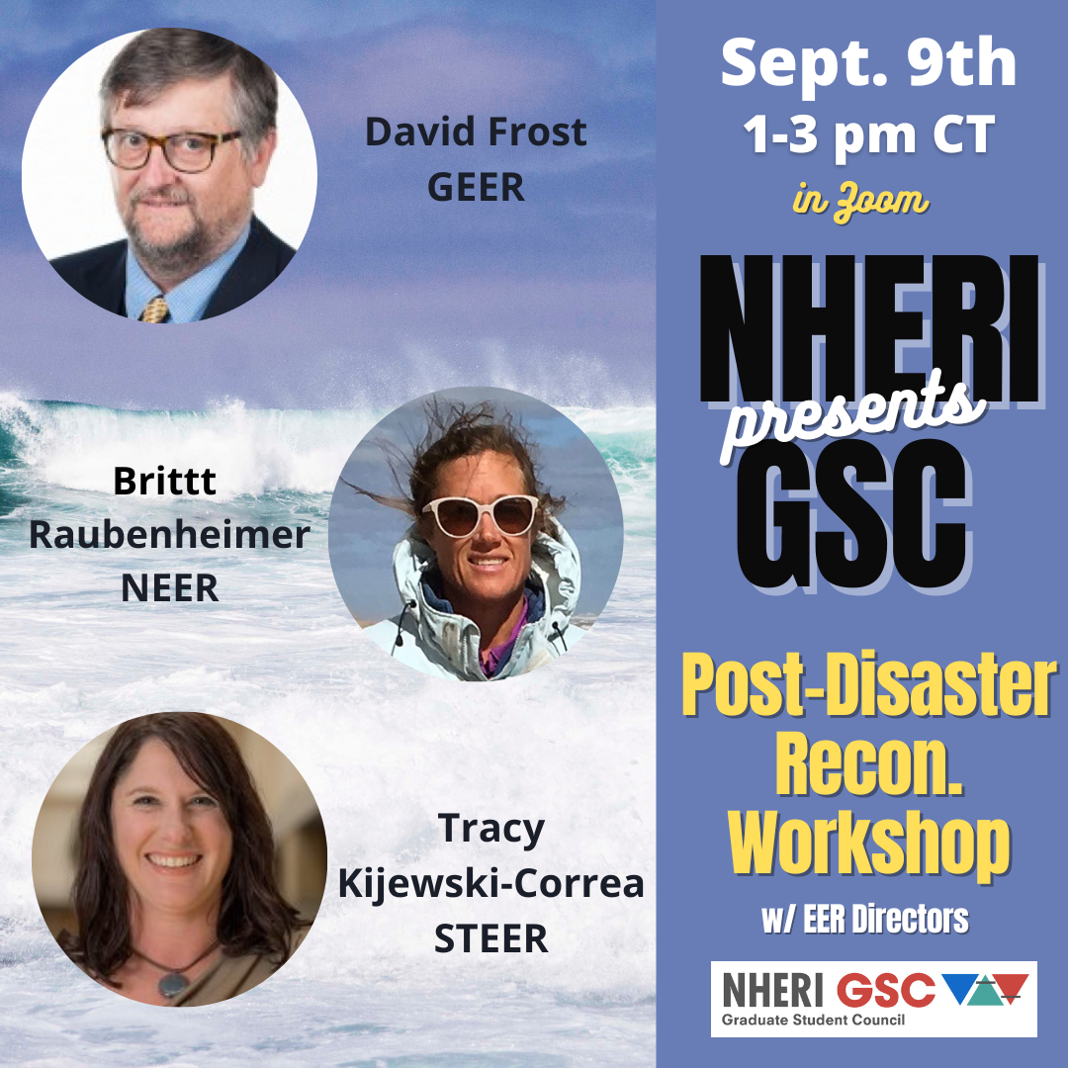
Register for
NHERI GSC post-disaster recon workshop
https://bit.ly/NHERIGSC_PDRW
Sept
9
1 – 3 p.m. CST

Slide 6
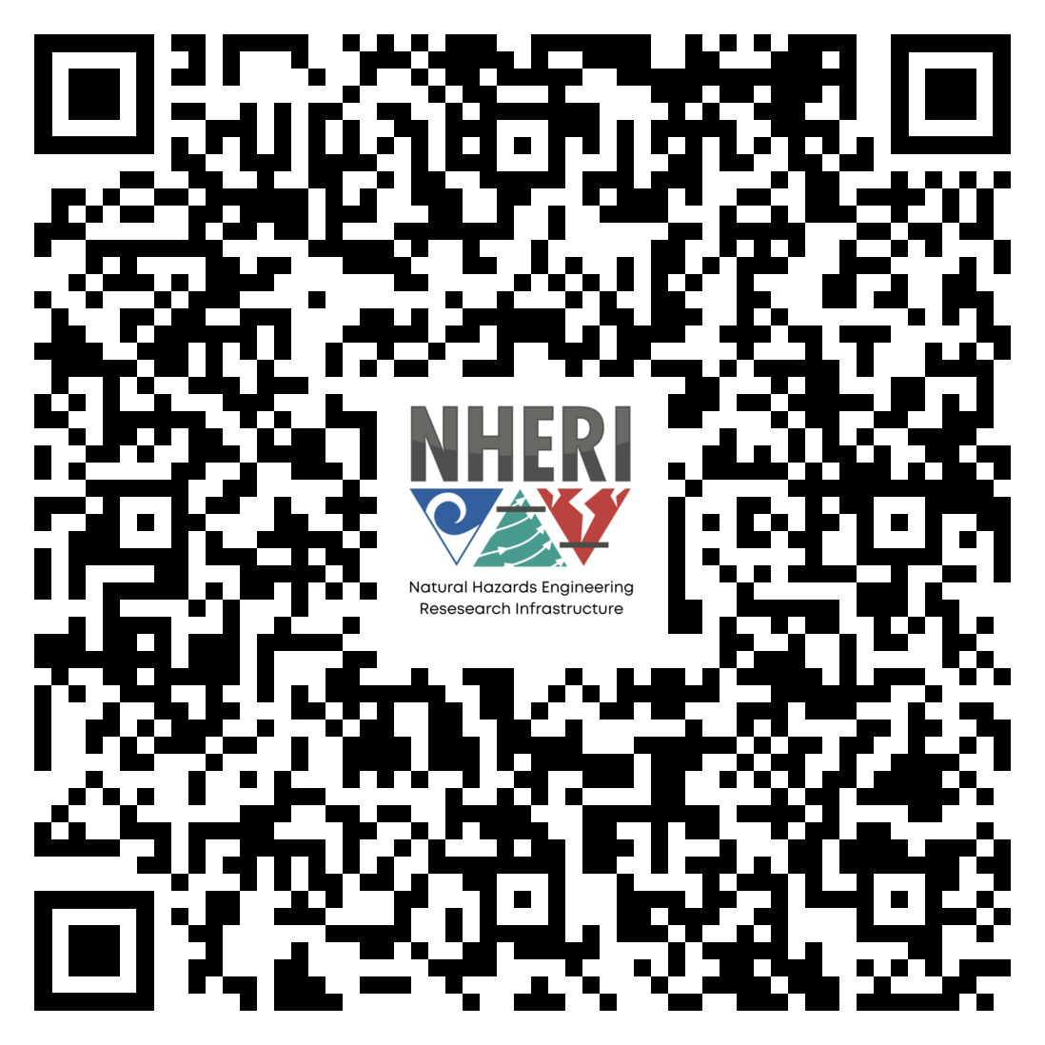
Register for
NATURAL HAZARDS RESEARCH SUMMIT 2022
October
6-7
Washington, DC
https://www.designsafe-ci.org/learning-center/training/nco/2022/natural-hazards-engineering-research-summit/overview/
Notes:
https://designsafe-ci.zoom.us/meeting/register/tJwufuqqqzIvGtccud5YOr45cD5P181IQnwa

Slide 7
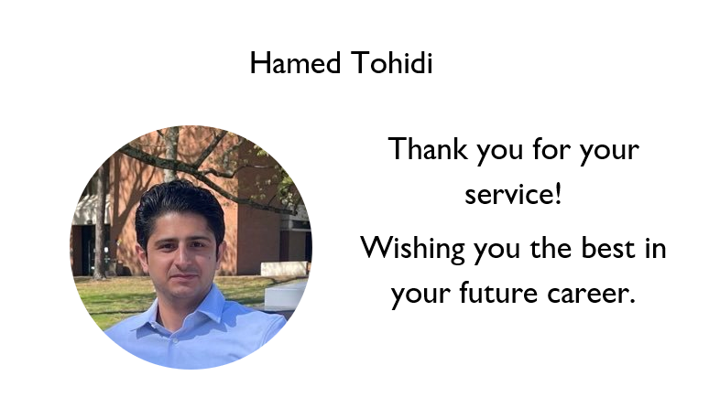

Slide 8
Upcoming Opening:
Vice-Chair of Research
Nominations due by Sept 2, 2022
https://bit.ly/NHERIGSC_Nominations
Sept
6
Nominate yourself
or
Nominate another member
Eligibility Criteria
Member in good standing
Attended 2 NHERI GSC Meetings last semester

Slide 9
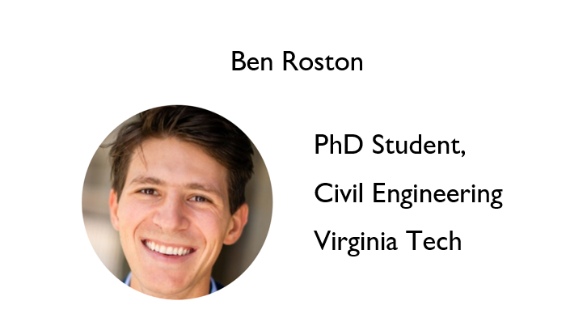
Notes:
Ben is a PhD student in Civil Engineering at Virginia Tech and is co-advised by Drs. Megan Rippy and Landon Marston. Supported by the NSF Graduate Research Fellowship Program (GRFP) and the Disaster Resilience and Risk Management (DRRM) Fellowship from Virginia Tech, his research focuses on modelling the evolution of environmental injustices produced by contemporary water resources management practices. Ben applies concepts from engineering, systems dynamics, and sociology to explore interdisciplinary questions like How do chronic socio-economic inequalities co-evolve with flood risk inequalities in floodplains? How can changes in decision- and policy-making processes address such inequalities? and How can de-centralized systems models be applied to explore these and other environmental justice issues?

Slide 10
Breakout Rooms (BR)
Please select a research area to participate.
Join the Research BR room that you are most interest in participating.
Earthquake
Wind
Tsunami
Coastal Engineering
Cyberinfrastructure
Simulation/Computational Modeling
Reconnaissance
Social Science

Slide 11

Future Meeting Dates
3rd Friday of every month at 11:00am
CST
September
16
Notes:
Tricia Clayton, Associate Professor Wake Forest University will be talking on mobile shakers.

