Slide 1
NHERI GSC
August General Meeting
Friday,
August 18
11:00am CST

Slide 2
Agenda
12:00-12:10 Welcome & Announcements
12:05-12:15 User Forum Survey with
Maggie Leon-Corwin
12:15-12:58 Presentation by Dr. Sumeet Sinah
12:58-1:00 Wrap up

Slide 3


Welcome New Members
Aaron | Dewar
Mojtaba | Harari
Dikshita | Nath
Nitin | Tiwari
Md Asad | Ahmad
Darshan | Pokharel
Keely | Patelski
Jay | Balagna
*Reach out to Julie Elliott and Elliot Nichols to learn how to get involved!

Slide 4
NHERI GSC NSF Proposal
NHERI GSC is working on a proposal for NSF!
For more information or to get involved, contact Treasure Elliot Nichols (enichols9@gatech.edu) or Vice Treasurer Nurullah Bektas (nurullahbektas@hotmail.com)!

Slide 5
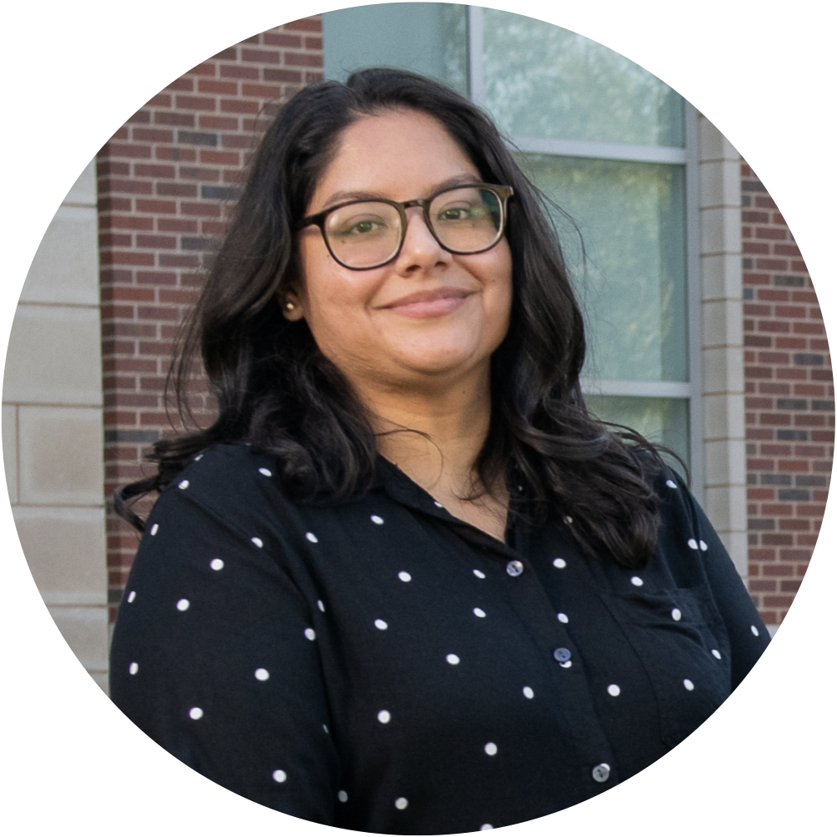
NHERI User Forum
Dr. Maggie Leon-Corwin
Postdoctoral Researcher
Institute for Public Policy Research and Analysis
University of Oklahoma
NHERI User Forum
Contractor

Slide 6

NHERI User Forum Survey
If you have conducted research at a NHERI facility or site, or used NHERI DesignSafe & SimCenter tools, please scan the QR code and share feedback on your experience.
Scan Me!
Notes:
I am so honored to introduce our speaker today, Dr. Tracy Kijewski-Correa.
Tracy Kijewski-Correa is professor of engineering and global affairs in the Keough School of Global Affairs at the University of Notre Dame with a joint appointment as the Leo E. and Patti Ruth Linbeck Collegiate Chair and Associate Professor in the Department of Civil and Environmental Engineering & Earth Sciences. She currently serves in a number of esteemed roles, including a co-director of the Integration Lab (i-Lab), part of the Master of Global Affairs program, the William J. Pulte Director (acting) of the Keough School’s Pulte Institute for Global Development, and as a fellow of the Keough School’s Kellogg Institute for International Studies. Additionally, she is co-founder of Engineering2Empower, an initiative with the stated mission of empowering community resilience in the developing world; is on the faculty board of the Real Estate Institute; and is an affiliated faculty member for Notre Dame’s Environmental Change Initiative.
Her research focuses on disaster risk reduction and civil infrastructure challenges posed by increased urbanization and vulnerability. Her interdisciplinary scholarship links science and technology to communities in greatest need, delivering scalable paradigms to enhance the resilience and sustainability of civil infrastructure and inform the decisions of stakeholders such as homeowners, designers, planners, emergency managers and policymakers.
Her work includes the design and launch of a new platform for coastal risk assessment and geospatial decision-support for the State of New Jersey called NJcoast, the green resilience project, and practitioner-facing integrated life-cycle analysis tools. A core faculty member in the NHERI SimCenter, she also serves as the inaugural director of the StEER network, drawing on her experiences coordinating responses to the 2017 Atlantic hurricane season to assess the damage caused by major Hurricanes Harvey, Irma, and Maria.
Dr. Kijewski-Correa joins us today to discuss a Journal Rejection Triage System for Natural Hazards Publications, a vital topic for graduate students whether submitting your first or fifth academic publication. Dr. Kijewski-Correa, I will now turn things over to you.

Slide 7
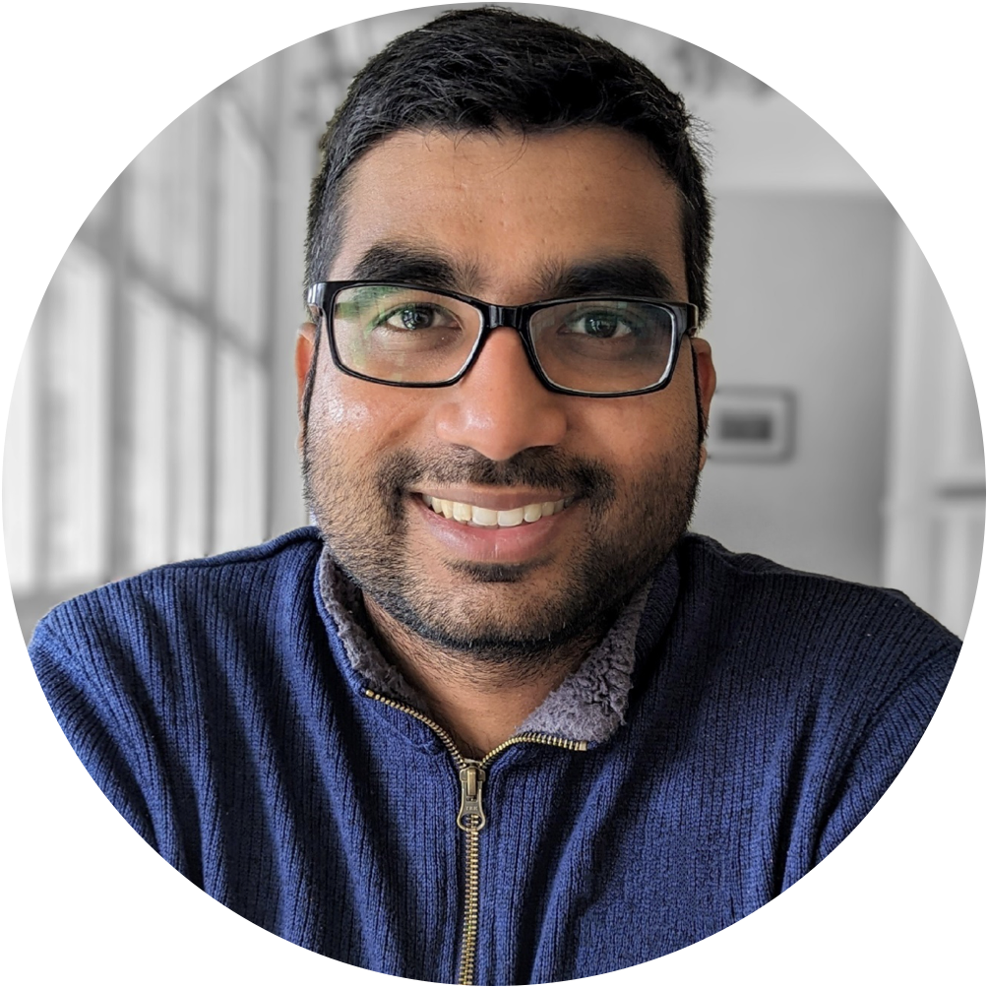
NHERI User Forum Survey
Dr. Sumeet Kumar Sinha
Assistant Professor
Dept. Civil Engineering
Indian Institute of Technology Delhi
sumeet.kumar507@gmail.com
Notes:
I am so honored to introduce our speaker today, Dr. Summeet Kumar Sinha.
Sumeet Kumar Sinha is an Assistant Professor in the Department of Civil Engineering at the Indian Institute of Technology Delhi. He received his undergraduate degree from the Indian Institute of Technology Delhi in 2014 and MSc and Ph.D. from the University of California Davis in 207 and 2022, respectively. He also holds a minor degree in computer science and engineering. Post PhD, he worked as a postdoctoral scholar in Soga Research Group at the University of California Berkeley on the development of distributed fiber optic sensing system and its application to civil infrastructures. His research interests include Liquefaction, Pile Foundation, Earthquake Engineering, Soil-Structure Interaction, Numerical Modelling, Energy Geotechnics, and Sensing Technologies. His research efforts are towards “Smart Geotechnics,” involving integration of innovative design, sensing technologies, and computational tools to make the geosystem’s design and performance more informed, feasible, economical, resilient, and sustainable.

Slide 8

Future Meeting Dates
3rd Friday of every month at 11:00am
CST
June
15

