Slide 1
NHERI GSC
December General Meeting
2022
Holiday
Social

Slide 2
Agenda
12:00-12:03 Welcome & Announcement
12:03-12:08 NHERI GSC Mini-Conference & Research Challenge
12:08-12:10 NHERI GSC User Forum Rep. Election
12:10-12:55 Trivia
12:58-1:00 Wrap-up

Slide 3


Welcome New Members
Min-Chun | Han
MITHILA | PARVIN
Jonathan | Yevuyibor
Wayne | Day
Jasmine | McAdams
Fatih | Polat
Maliha | Binte Mohiuddin
Anika Tabassum | Sarkar
Wolduamlak | Ayele
Sujanraj | Devkota
Ayat | Al Assi
Susamma | Seeley
Morufu | Raimi
Jocelyn | West
Shriya | Thakkar
Shelley | Hoover
Jiayun Shen | Shen
Candela | Cerpa
Sarina | Patel
Jaideep | Visave
Lauren | Prox
Genesis | Leong
Srijesh | Pradhan
Hamidatou | Mouloud
Ashley | Moore
Negar | Ghahramani
Marie | Wise
Katherine | Riddle
Gibran | Cano Gutierrez
Ashlee | Sellung
Dean | Desautels
Lavinia | Taumoepeau
Notes:
https://designsafe-ci.zoom.us/meeting/register/tJwufuqqqzIvGtccud5YOr45cD5P181IQnwa

Slide 4

NHERI Summer Institute
Learn more about the NHERI Summer Institute and how to tailor your application on Monday, December 19th @ 5:00 pm CST. Register for the free virtual information
session: https://bit.ly/LearnAboutSummerInstitute.
June
21-23
https://bit.ly/2023NHERI_SummerInstitute
Notes:
https://designsafe-ci.zoom.us/meeting/register/tJwufuqqqzIvGtccud5YOr45cD5P181IQnwa

Slide 5


The NHERI GSC Research and Workshop and Mentoring Working Groups are excited to announce TWO new opportunities for Spring 2023!
NHERI GSC Mini-Conference & Research Challenge
Mini-Conference
We encourage all NHERI GSC members to present their ongoing research in the field of natural hazards! Individual presentations can be posters or papers from any discipline as long as they address key challenges focused on natural hazards. Abstracts will be due Friday, February 17, 2023.
Collaborative, Interdisciplinary Research Challenge
We would like to facilitate new, innovative, and interdisciplinary collaborative research among NHERI GSC members. Groups assigned by the organizing committee will work together throughout the spring and present their preliminary findings at the NHERI GSC mini-conference in May 2023. If you are interested in participating, please submit your application by Friday, January 13, 2023.

Slide 6
Key Dates for NHERI GSC Mini-Conference & Research Challenge
Collaborative Research Challenge Applications due on January 13, 2023
Collaborative Research Challenge groups will be notified by January 20, 2023
Mini-Conference Abstracts & Research Challenge Abstracts are due on Friday, February 17, 2023
Acceptances to the Mini-Conference will be sent out by March 24, 2023.
NHERI GSC Mini-Conference will be held Friday, May 26th 2023

Slide 7


HOW TO PARTICIPATE
Apply to either or both of these opportunities by completing the forms below by the deadlines:
Mini-Conference Application Form
bit.ly/3YuD7Hj
Collaborative Research
Challenge Application Form
bit.ly/3hy2Vle
Notes:
Research Challenge: bit.ly/3hy2Vle (Applications due January 13, 2023)
Mini-Conference: bit.ly/3YuD7Hj (Abstracts for paper, poster, and/or presentation due February 17, 2023)

Slide 8
Thank
you!
Organizing Committee
Taylor Heath
Chair of Research
theath@sas.upenn.edu
Rakesh Salunke
Vice Chair of Research
rakesh.salunke@students.jsums.edu
Jasmine Bekkaye
Chair of Workshop & Mentoring
jbekka1@lsu.edu
Olaniyi Afolayan
Vice Chair of Workshop & Mentoring
oda0002@auburn.edu
Notes:
Thank You Slide (share after presenter’s presentation)

Slide 9
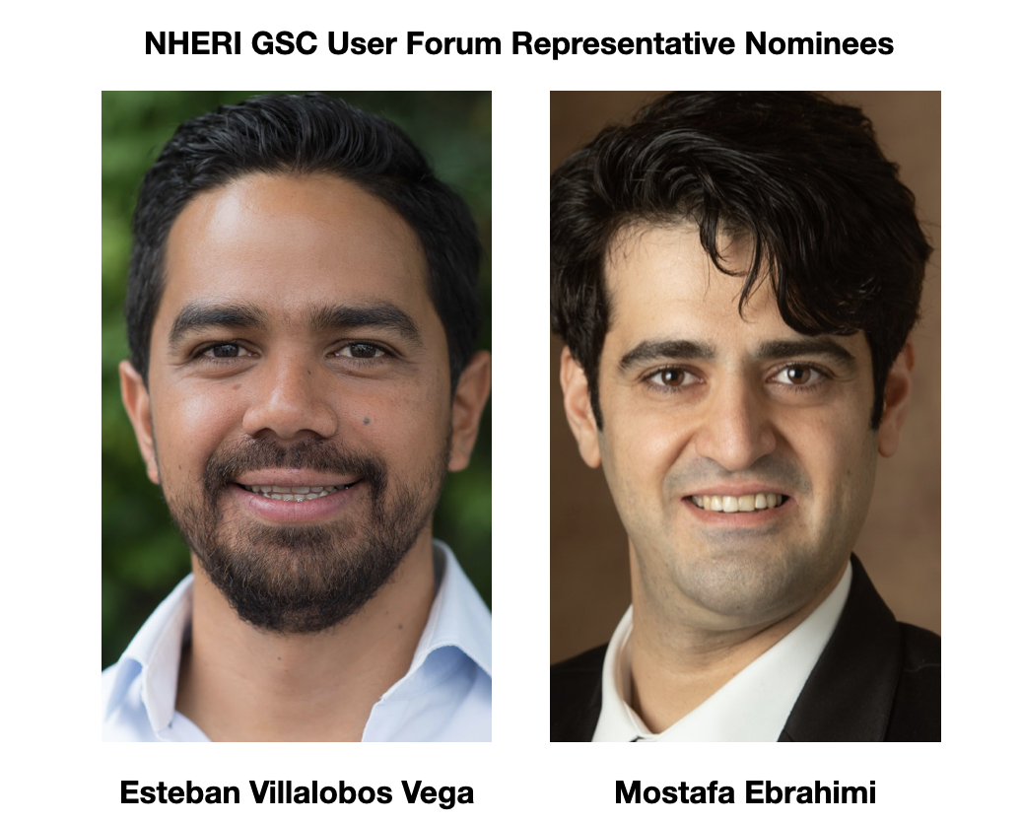
NHERI GSC User Forum Rep.
ELECTION

Slide 10

Future Meeting Dates
3rd Friday of every month at 11:00am
CST
January
20

